Slide 1
Flight Price prediction
Problem Statement:
Anyone who has booked a flight ticket knows how unexpectedly the prices vary. The cheapest available ticket on a given flight gets more and less expensive over time. This usually happens as an attempt to maximize revenue based on - 1. Time of purchase patterns (making sure last-minute purchases are expensive) 2. Keeping the flight as full as they want it (raising prices on a flight which is filling up in order to reduce sales and hold back inventory for those expensive last-minute expensive purchases) So, you have to work on a project where you collect data of flight fares with other features and work to make a model to predict fares of flights.
This project contains of two phases:
Data collection using selenium and beautiful soup from yatra.com
Model building phase.,
Data cleaning
Exploratory data analysis
Data Pre-processing
Model building and
model evaluation

Slide 2
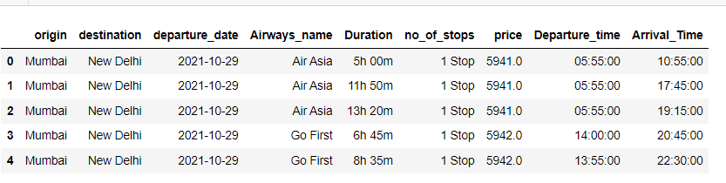
EDA
Data contains the below features
And the shape of the data is 3121, 9

Slide 3
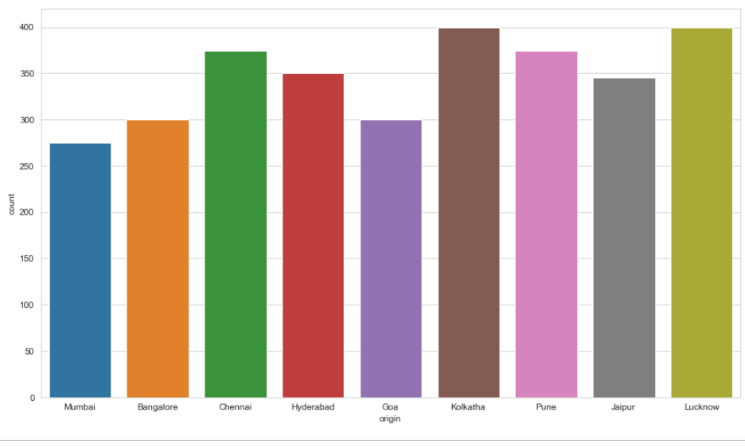
Place of Origin
all the fight details scrapped are originated from Mumbai, Bangalore, Chennai, Hyderabad, Goa, Kolkatha, Pune, Jaipur and Lucknow. And the maximum flights are from Kolkatha and Lucknow

Slide 4
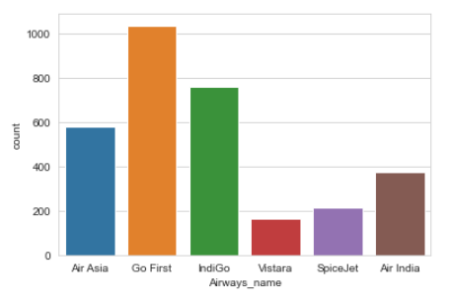
Airways_name
This data set contains data of 6 airways as shown below and IndiGo and Go First is high in the given data set

Slide 5
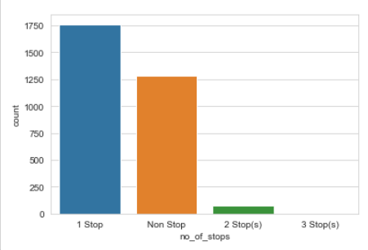
no_of_stops
1 stop flight are hihg in this data set, i.e., 1781 non stop flights are nearly 1316 2 stops flights are 73 and 1 3 stops flight

Slide 6
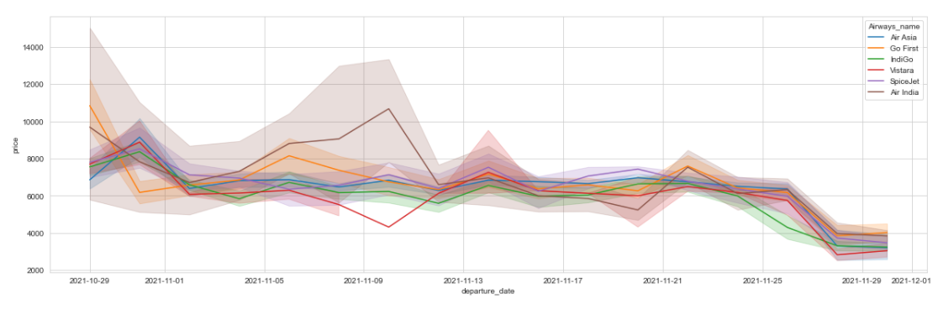
Airways Vs Price
Flight ticket prices are not frequently changing, but the flight ticket prices are at high before between 3 to 7 days from depature date in this data set
flight tivcket price is at its cheapest almost a month before the departure date as shown above

Slide 7
Airways Vs travel_Cities
in this data set,
Indigo airways charge lessesbetween Delhi to Mumbai
Indigo airways charge lessesbetween Delhi to Bangalore
Vistara airways charge lessesbetween Delhi to Chennai
Airindia airways charge lessesbetween Delhi to Hyderabad
Airindia airways charge lessesbetween Delhi to Goa
Indigo airways charge lessesbetween Delhi to Kolkatha
Airindia airways charge lessesbetween Delhi to Pune
Air Asia airways charge lessesbetween Delhi to Jaipur
Vistara airways charge lessesbetween Delhi to Lucknow

Slide 8
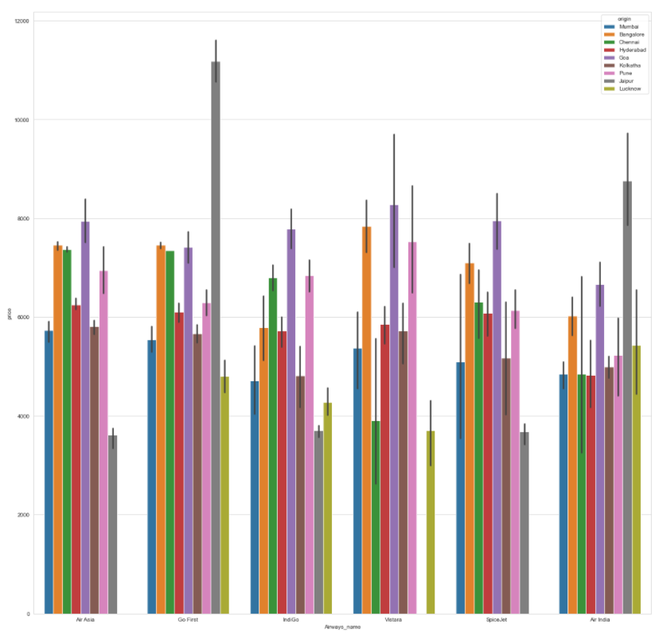

Slide 9
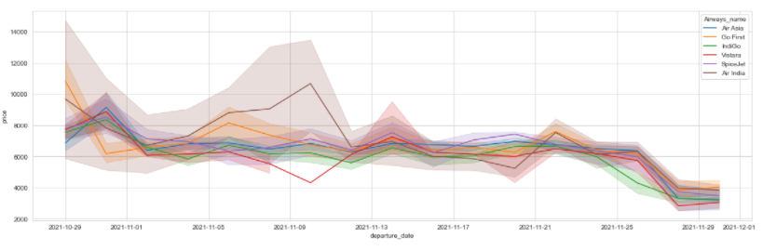
Airways Vs Price
Vistara is cheaper in this given data set, followed by Indigo, Air asia, Spice jet, Air india and go first

Slide 10
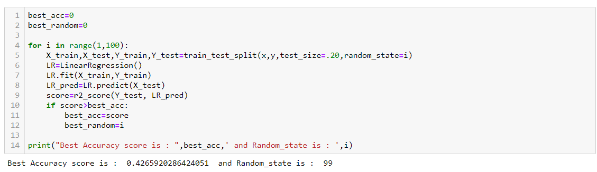
Model Building
Linear regression
Cross Validation

Slide 11
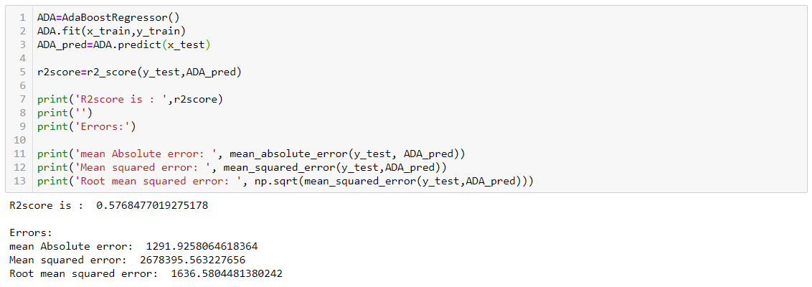
Model Building
ADA Boost regression
Cross Validation

Slide 12
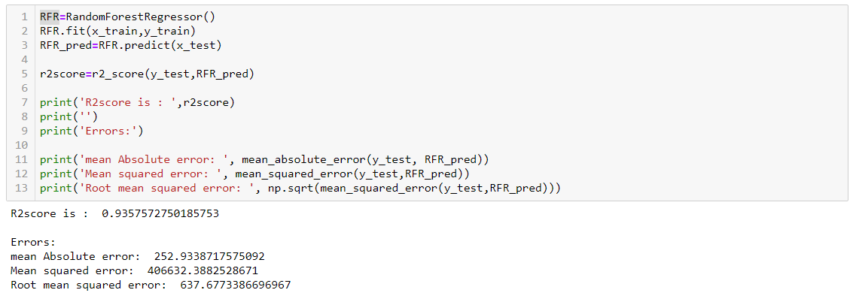
Model Building
Random forest regression
Cross Validation

Slide 13
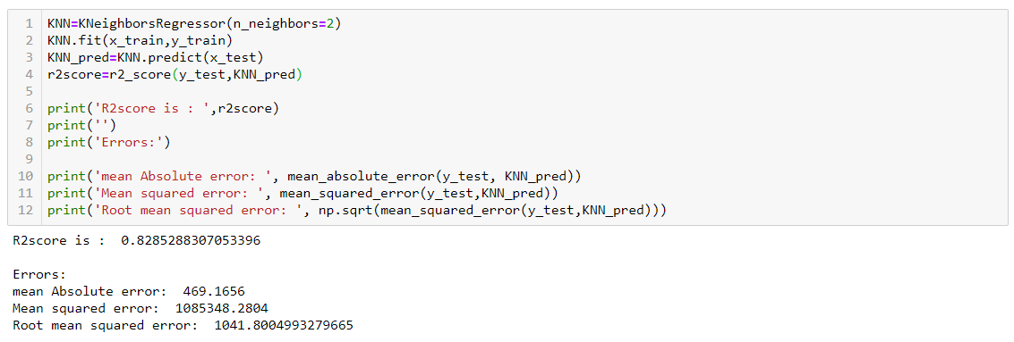
Model Building
KNN regression
Cross Validation

Slide 14
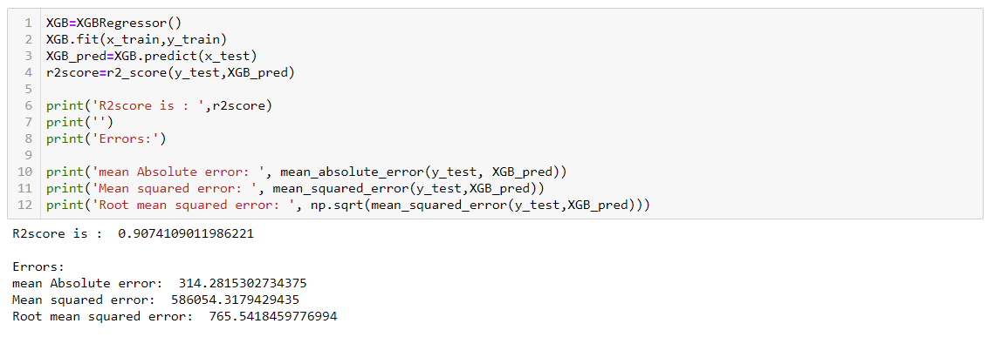
Model Building
XGBoost regression
Cross Validation

Slide 15
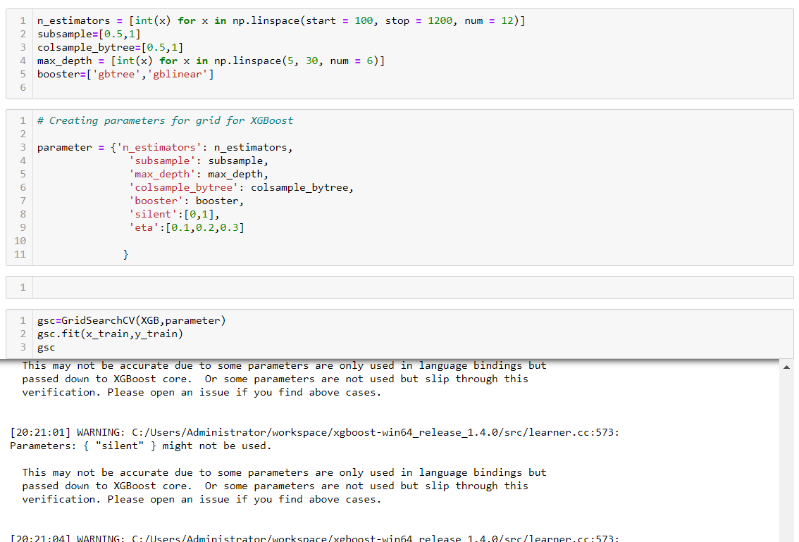
Hyper parameter tunning

Slide 16
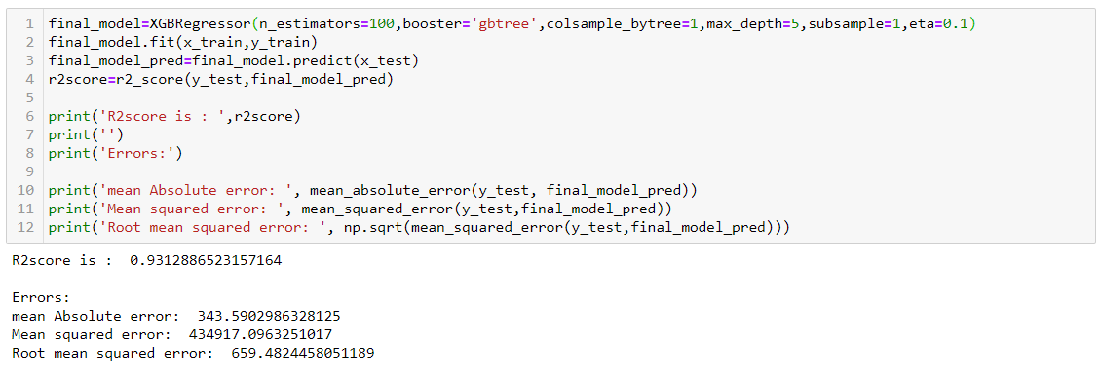
Final model

Slide 17
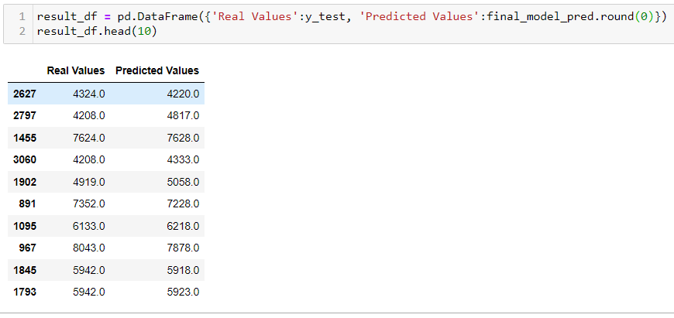
Actual Vs Predicted

